Slide 1
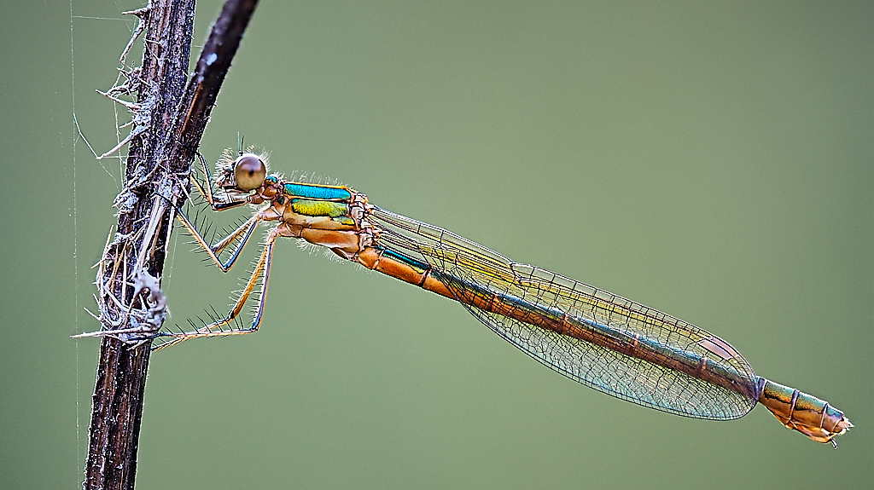
Macro and Close up Photography
Graham Morrice
PDI Competition Secretary

Slide 2
Why Macro Nature Photography?
When I took this image of an emergent Common Hawker Dragonfly in 2016 little did I realise it would start a bit of an obsession!
Being close to an event like this definitely stimulated me to do more
I had the inclination and time to spend hours around ponds and I’ve learned a lot about insects, their behavior but not their Latin names..yet
Almost unlimited supply of subjects!!
Joining the RPS Nature Group further reinforced the interest to achieve better results

Slide 3
Equipment for Macro and Close Up Photography
Olympus User—Micro Four Thirds System
Camera Bodies EM1 MKI and MKII
Lenses: 40-150mm f2.8 and 1.4 and 2.0 MC teleconverters, 60mm f2.8
Close focusing: 40-150mm is ~70cm and 60mm is 19cm
Tripod is currently Al Vanguard with ball head with Macro Arm attachment
Raynox 250 close up lens for higher magnifications
Velbon Focus Rail but clumsy in field
Post Processed in Capture One Pro 20.0.4 SW

Slide 4
Fieldcraft
Avoid high wind conditions
Avoid bright sunlight-overcast days with diffused light better
Rain can sometimes help to get interesting effects
Insects are quite tolerant to photographers but you need to approach slowly towards the target just in case it flies off
Prepare to get wet-need wellies at most dragonfly sites
Avoid use of flash guns

Slide 5
Olympus In Camera Focus Stacking to extend DoF
The camera takes 8 now 15 sets of images (raw and jpeg) then in camera produces a jpeg (17 images in total) a few seconds later
First image at focussed point
Then focal length adjust in increments defined by a Differential factor (1-10) found by trial and error suggest 3 to start
Use f number up to f8 but no higher as diffraction effects start to come into play

Slide 6
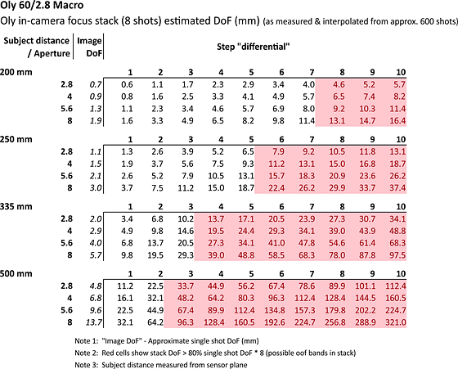
From DP Review Lester 11 Dec13 2016

Slide 7
Practical Problems with Focus Stacking -Wind -Insect Movement -Memory Bloat
Say I take 100 subject images (typical nature trip) using focus stacking… that means 1500 raws, 1500 jpegs and 100 “stacked” jpegs….in total 3100 images to review ….a big job to review and loads of memory required
Now decided to use Photo Mechanic software package for speed of review, selection and culling prior to loading into Capture One

Slide 8
Background is ALL IMPORTANT
If possible get separation between the subject and the background
“Chimp” and review the recorded image on the LCD viewer
Judges will always mark down excessive background detail
However not always possible!

Slide 10
Telemacro or Macro
Telephoto lens on a tripod to stand off from target-little or no disturbance usually about a metre away
Currently use a 40-150mm f2.8 with 1.4 and 2.0 extender to get 112 to 600mm equivalent
60mm Macro Lens very close about 20 cm working distance to get full 1:1 reproduction-disturbs insect and difficult to light

Slide 11
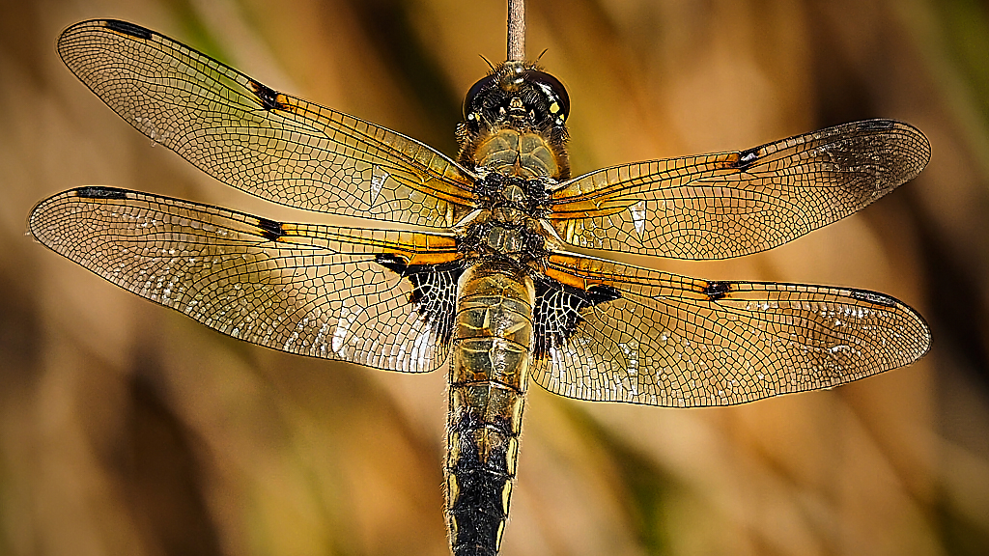

Slide 12
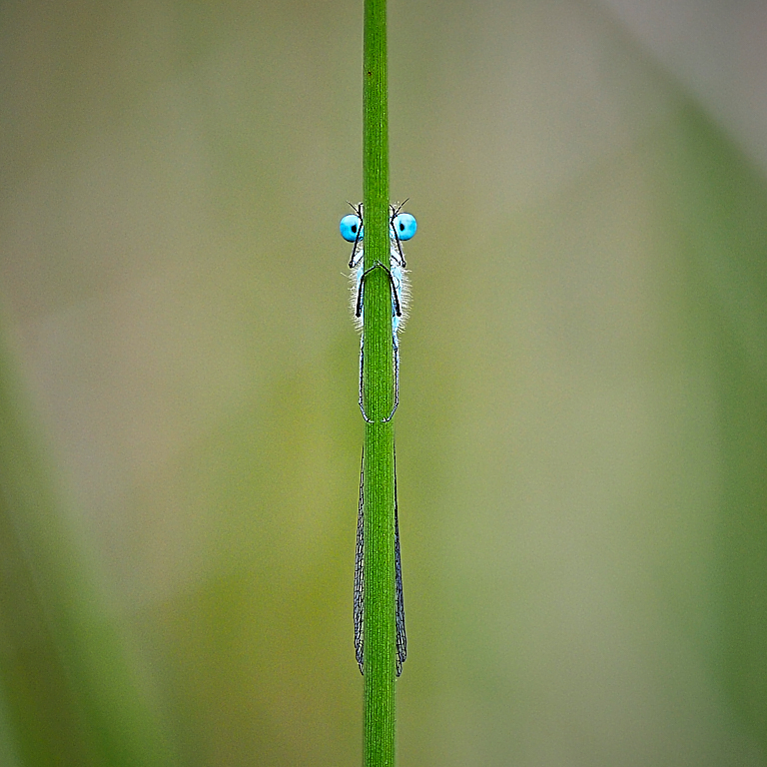

Slide 13
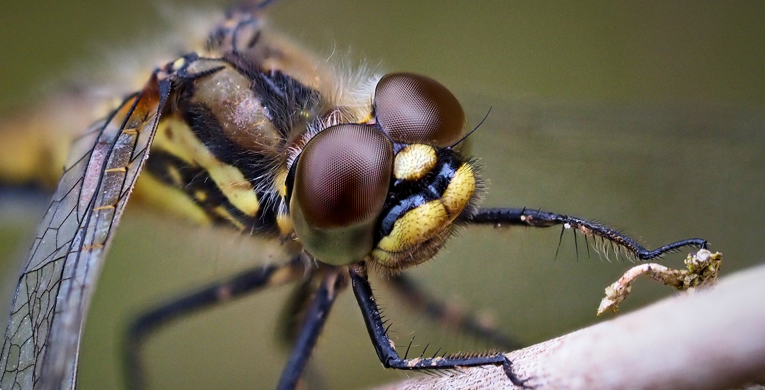

Slide 14
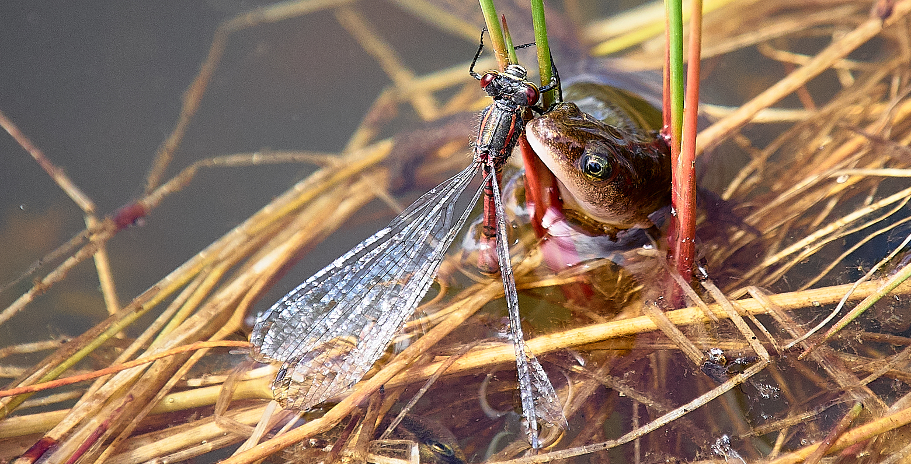

Slide 15
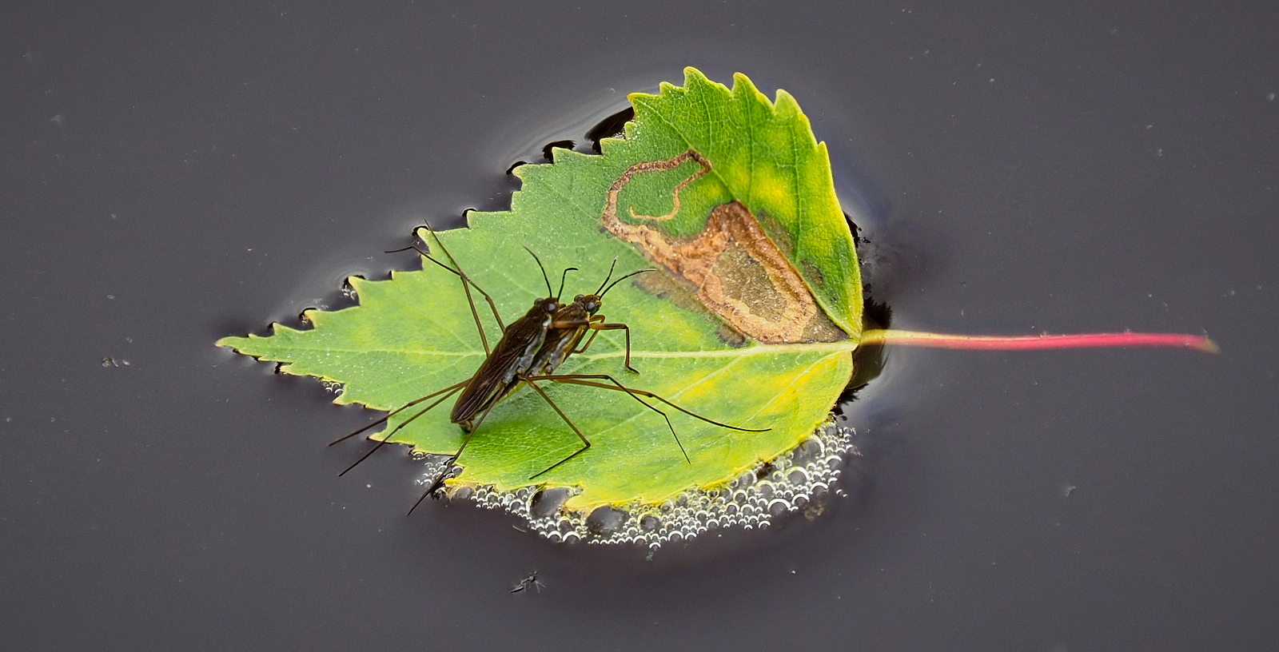

Slide 16
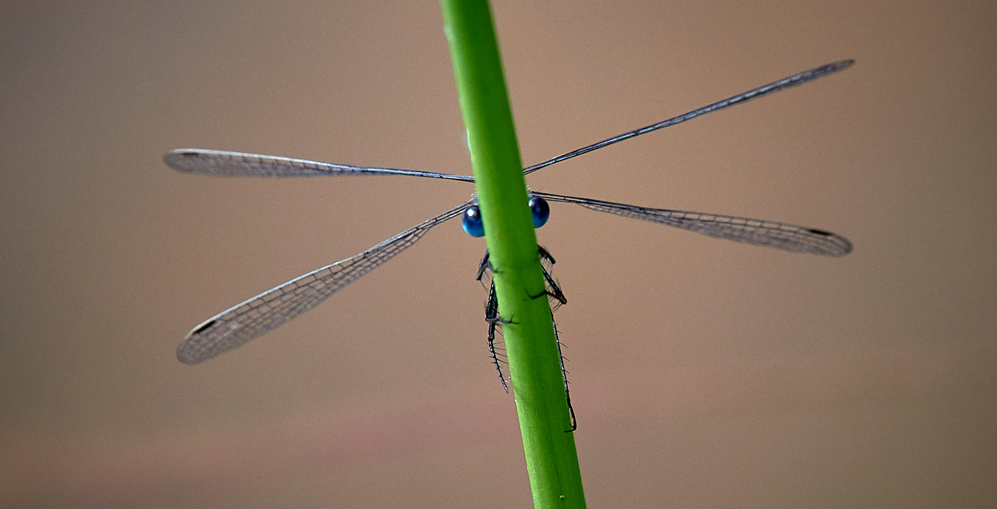

Slide 17
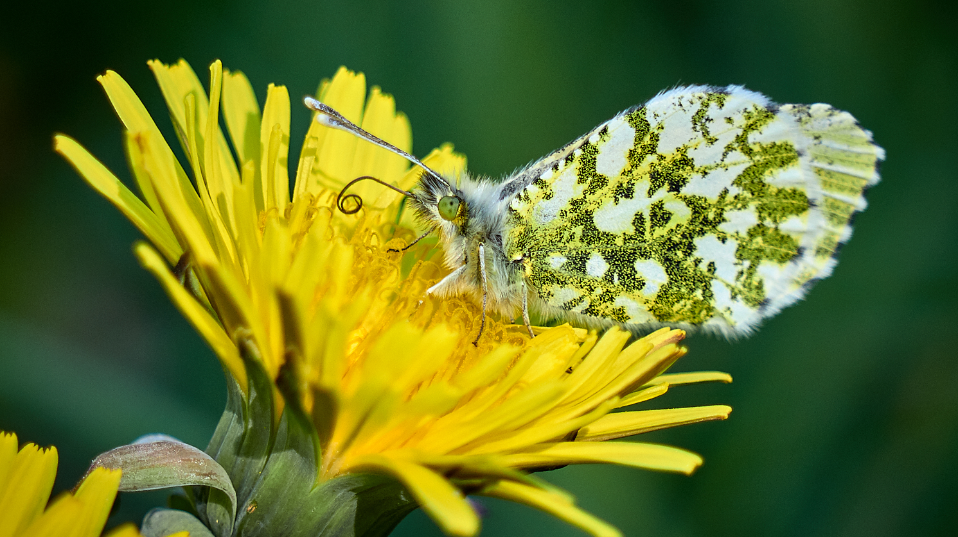

Slide 18
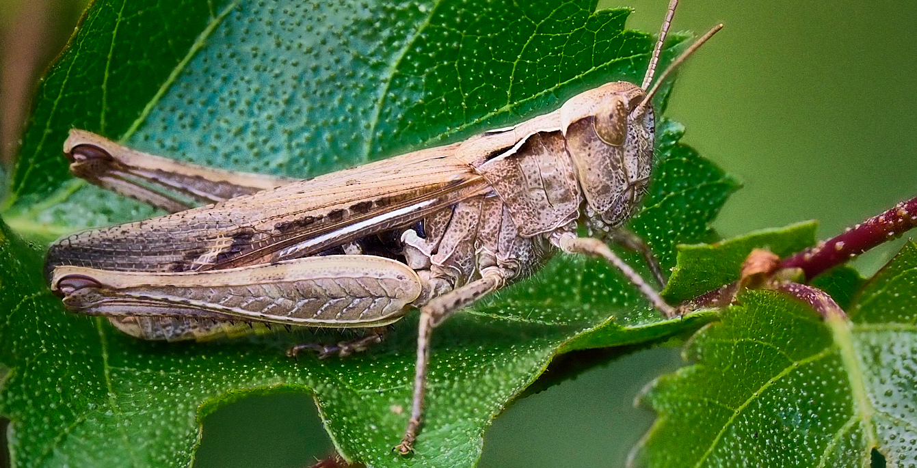

Slide 19
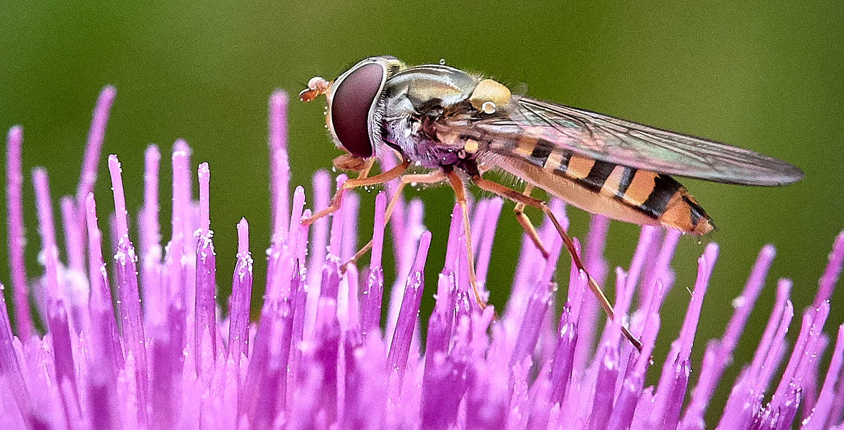

Slide 20
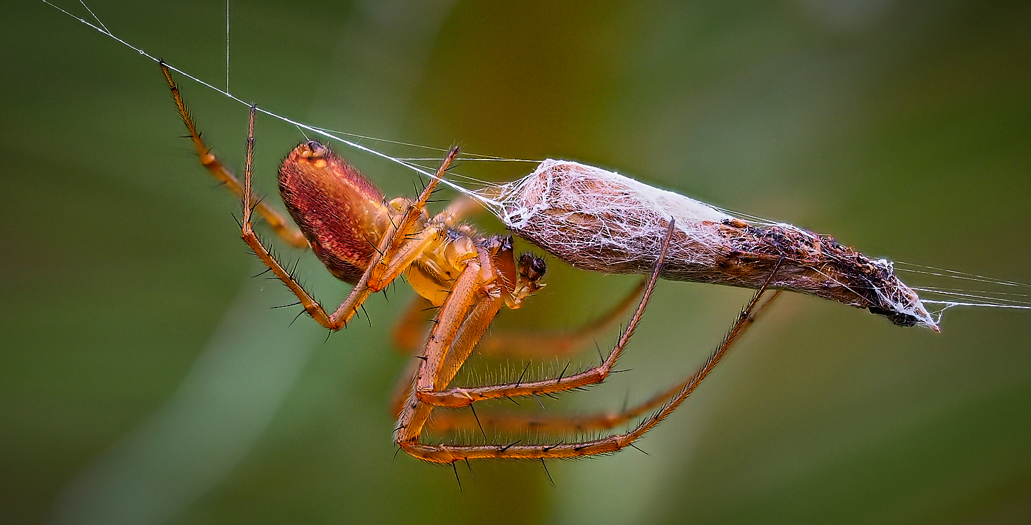

Slide 21
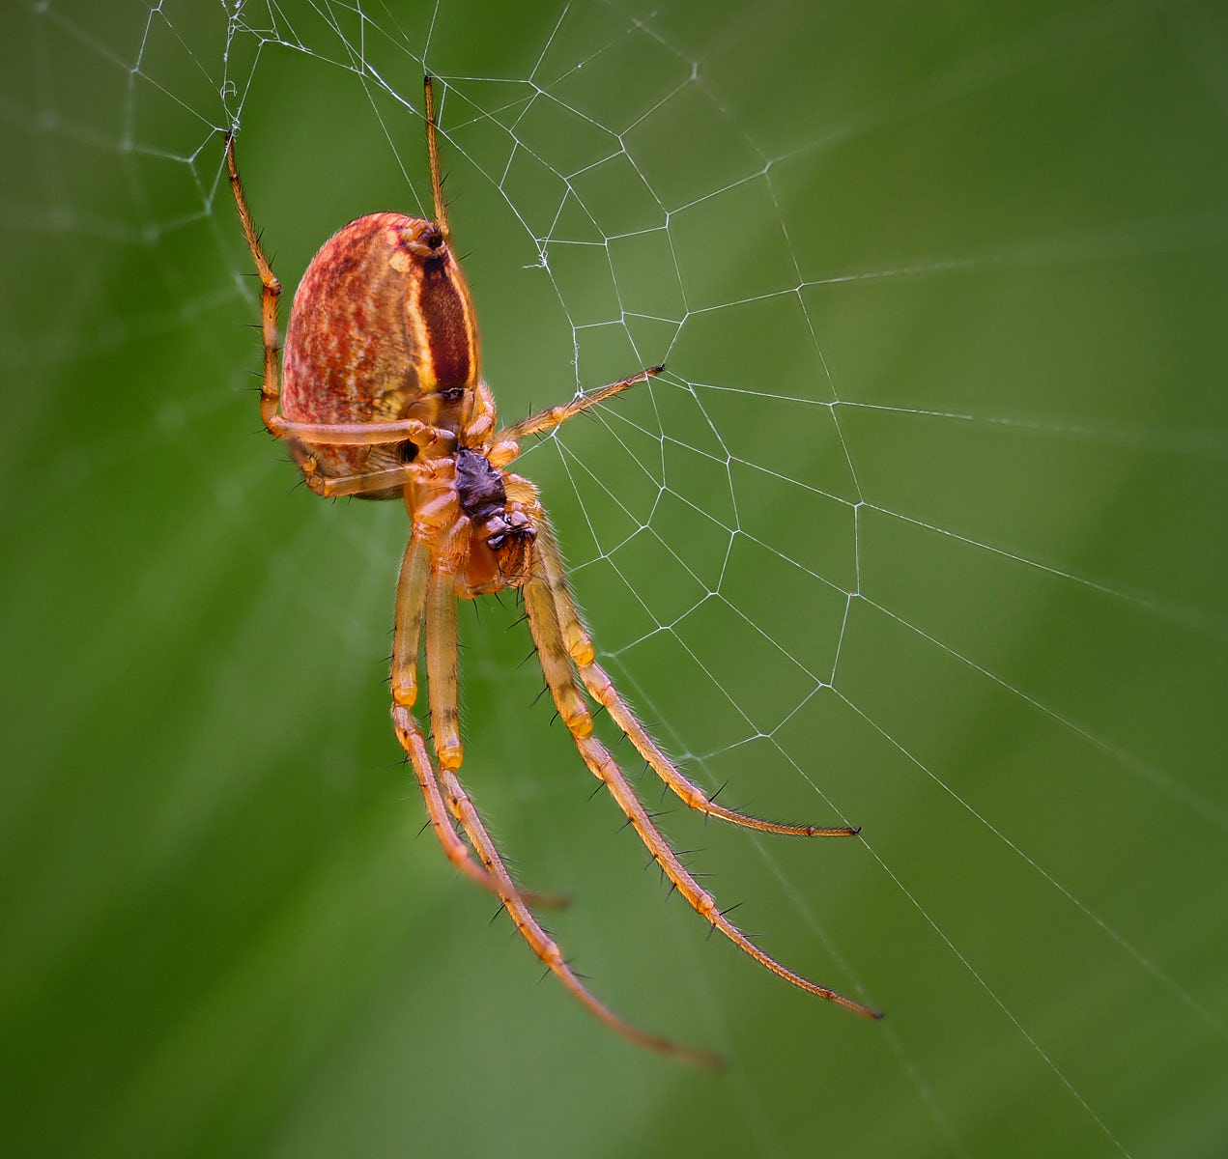

Slide 22
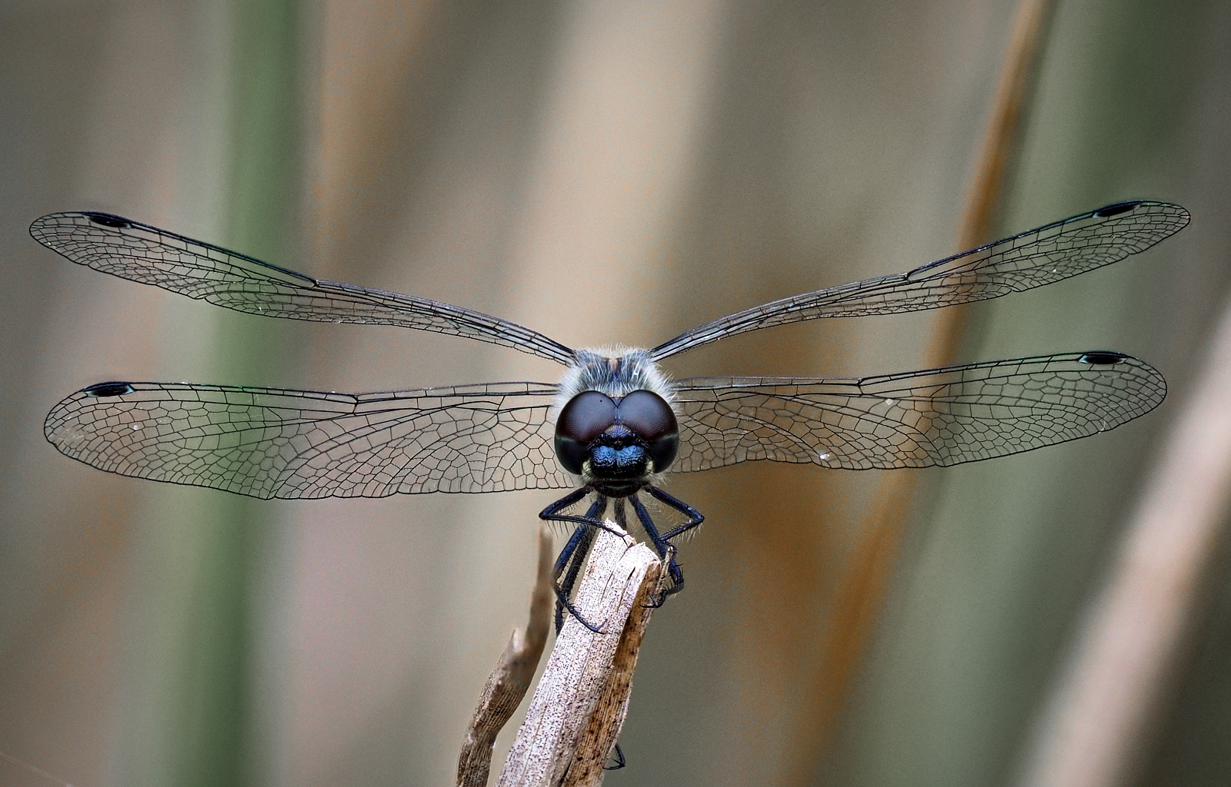

Slide 24
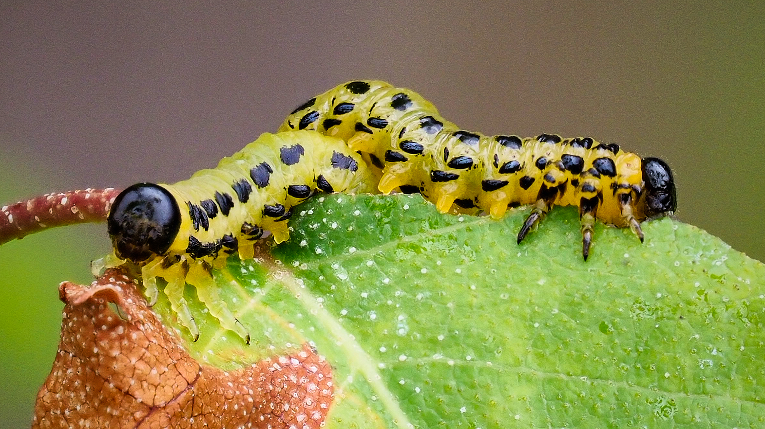

Slide 25
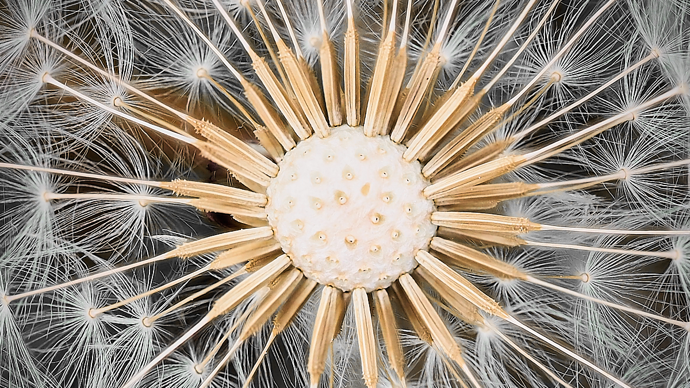

Slide 26
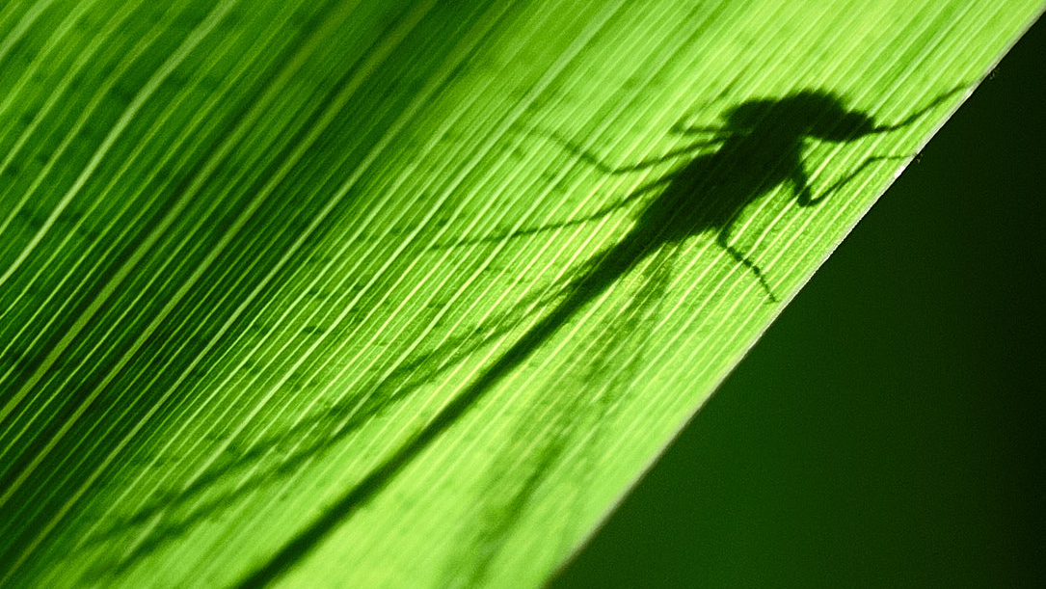

Slide 27
Wide Angle Macro
Use of a wide angle zoom leads to new possibilities for macro
7-14mm f 2.8 Olympus or Panasonic 7-14mmf4 are available for Micro 4/3
These lenses are capable of very close focus
Can see more of the surrounding contextual environment

Slide 28
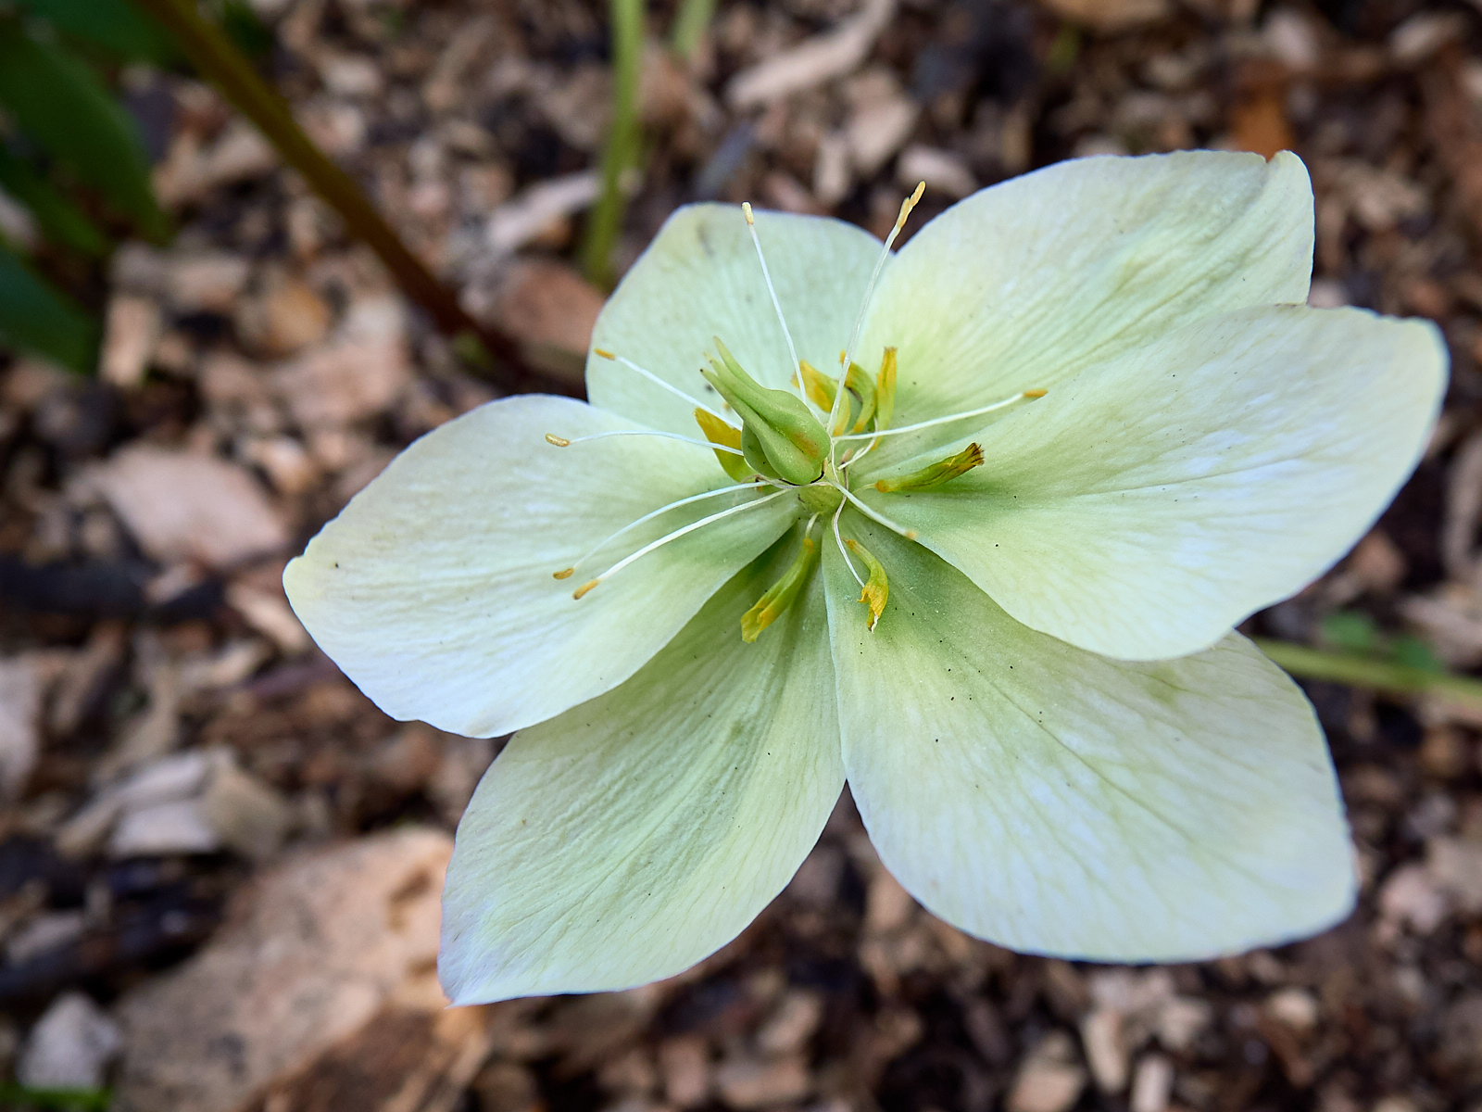

Slide 29
Recent Foral Images from Starbank Park in Trinity

Slide 30
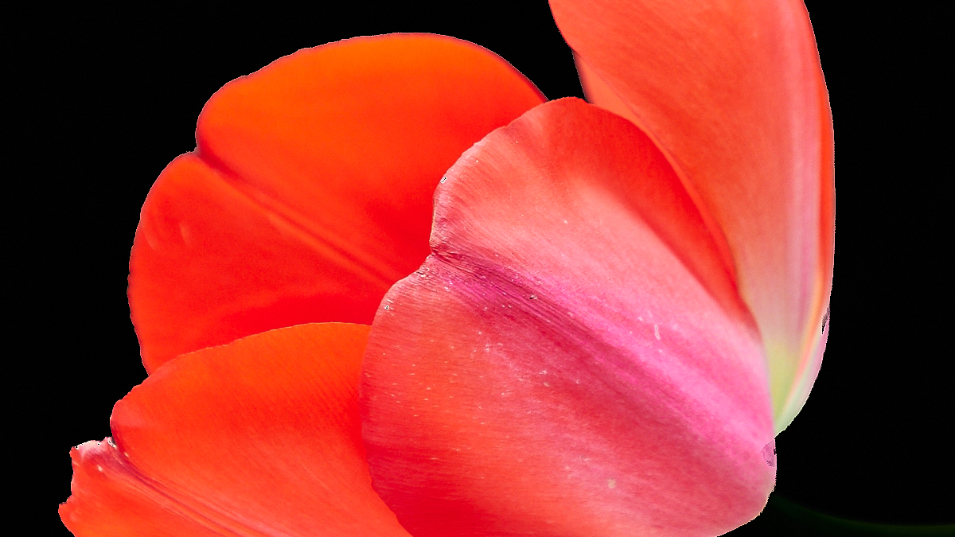

Slide 31
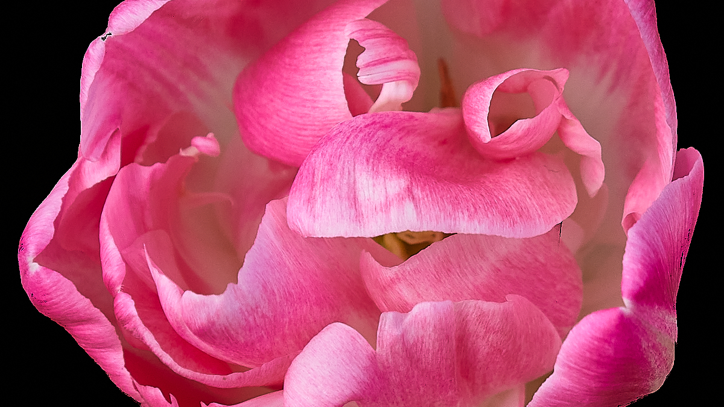

Slide 32
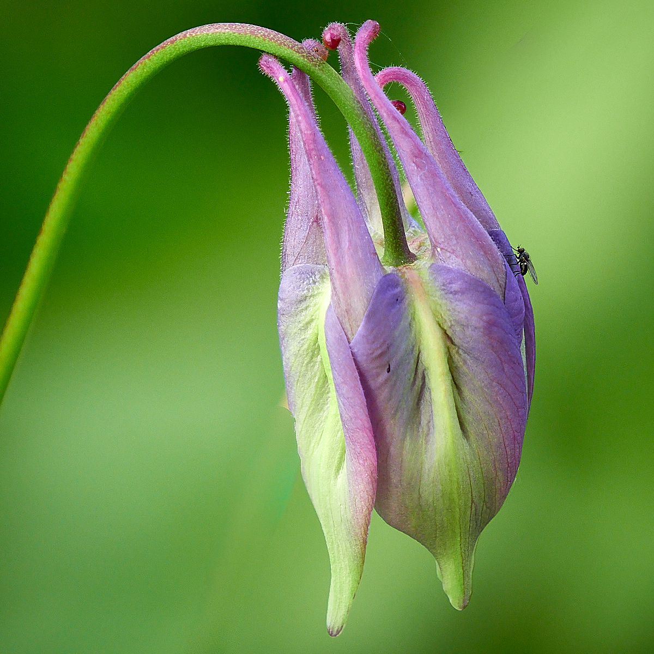

Slide 33
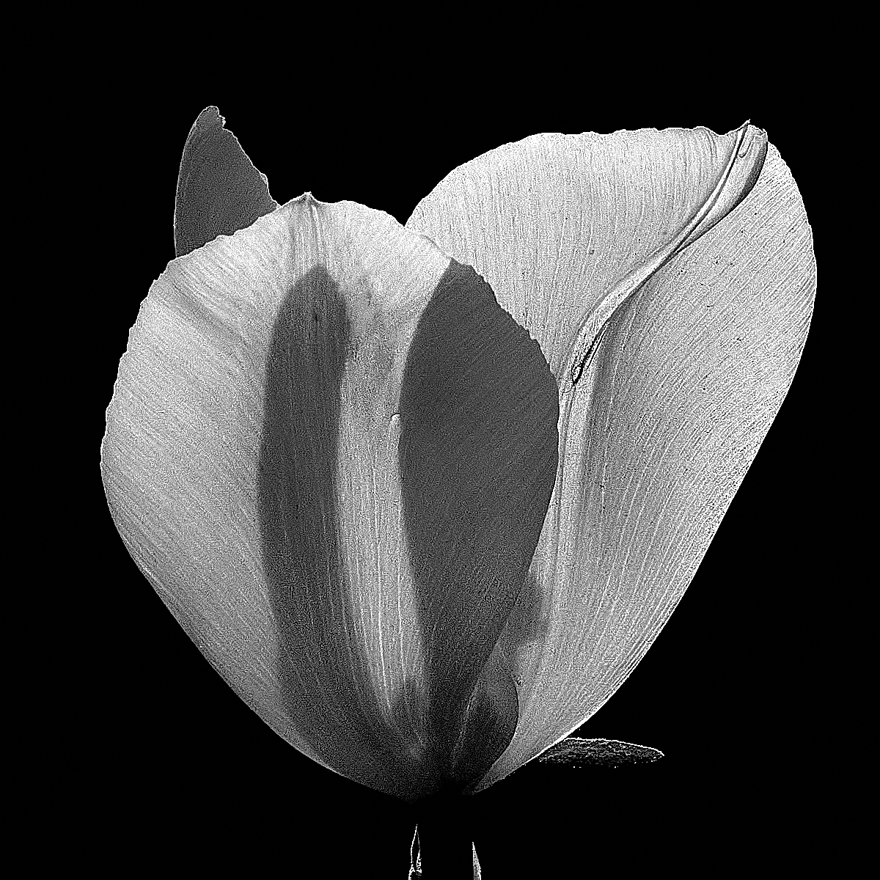

Slide 34
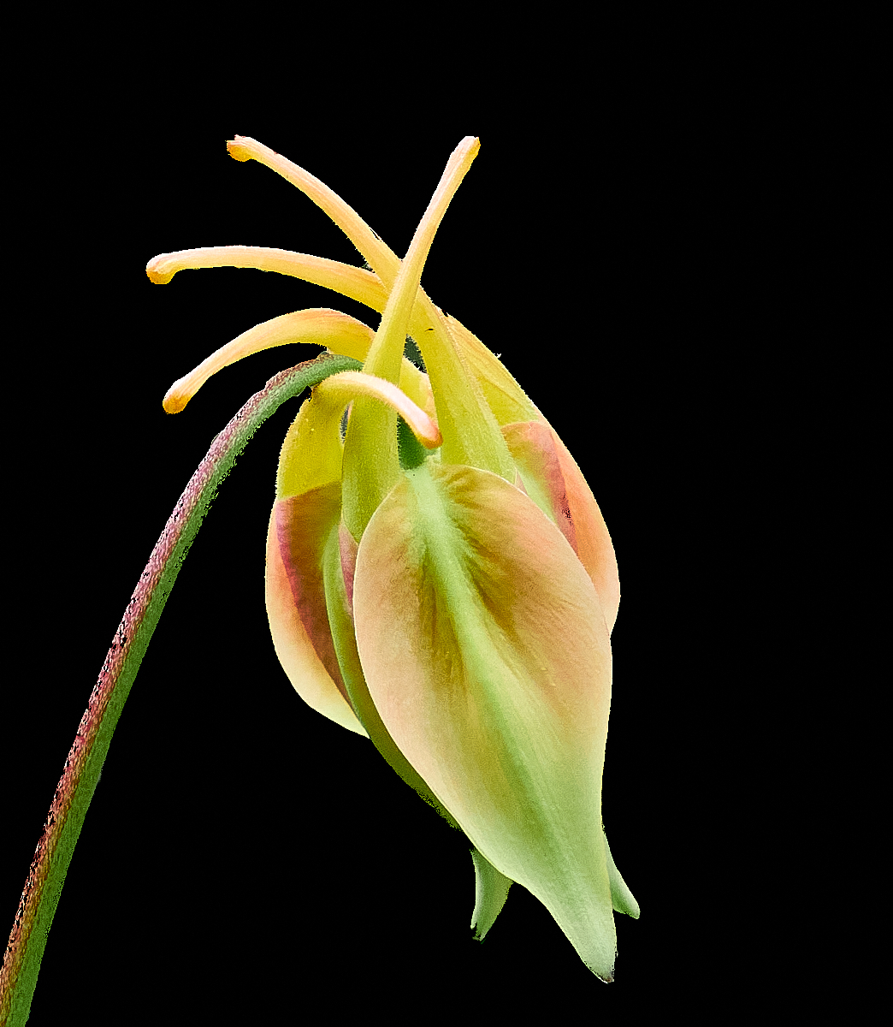

Slide 35
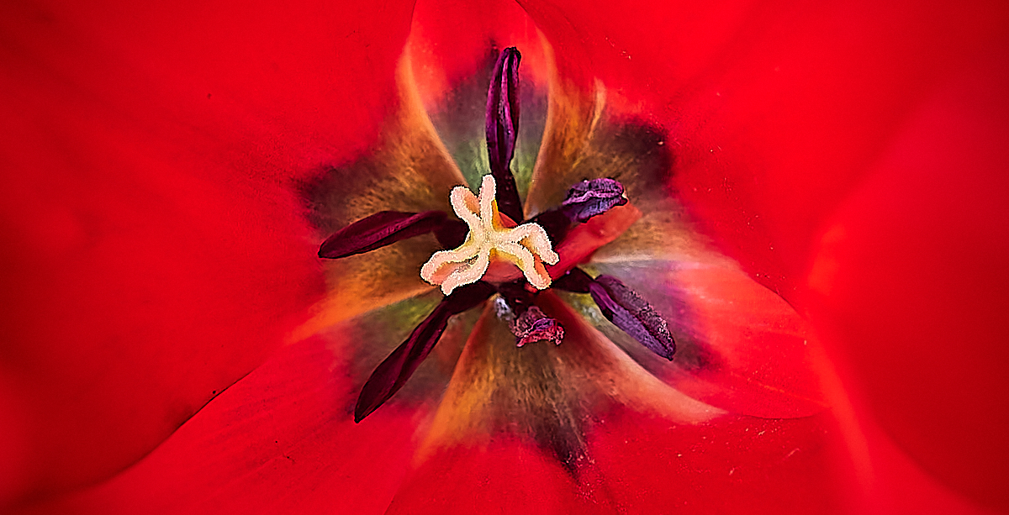

Slide 36
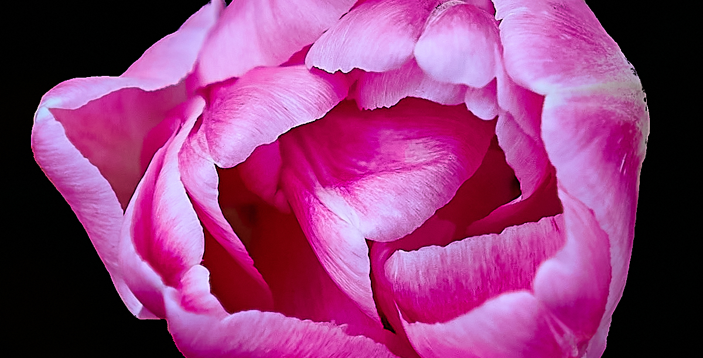

Slide 37
Dining Room Table Series

Slide 38
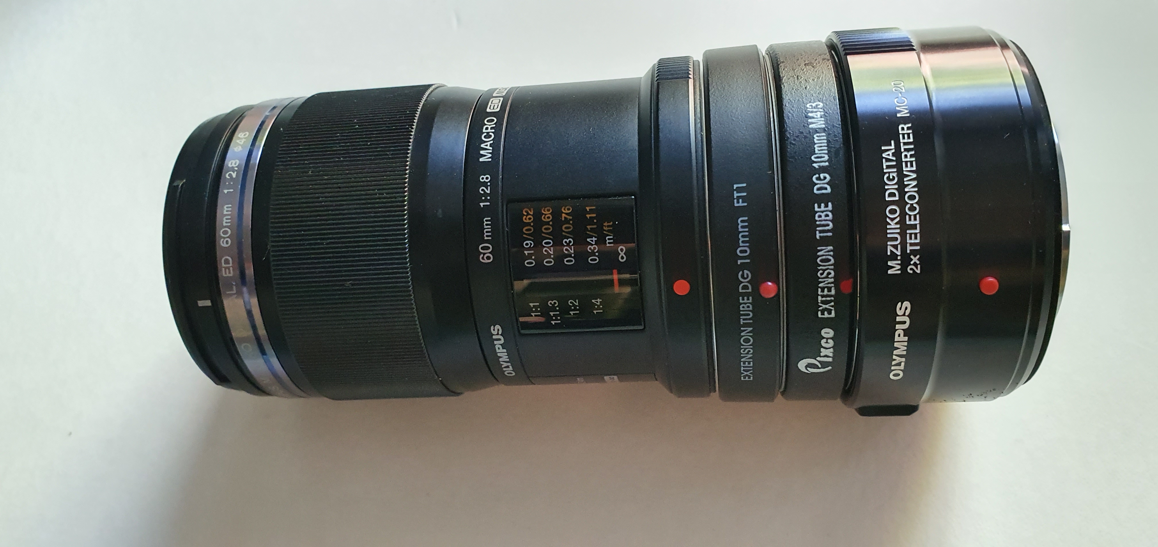

Slide 39
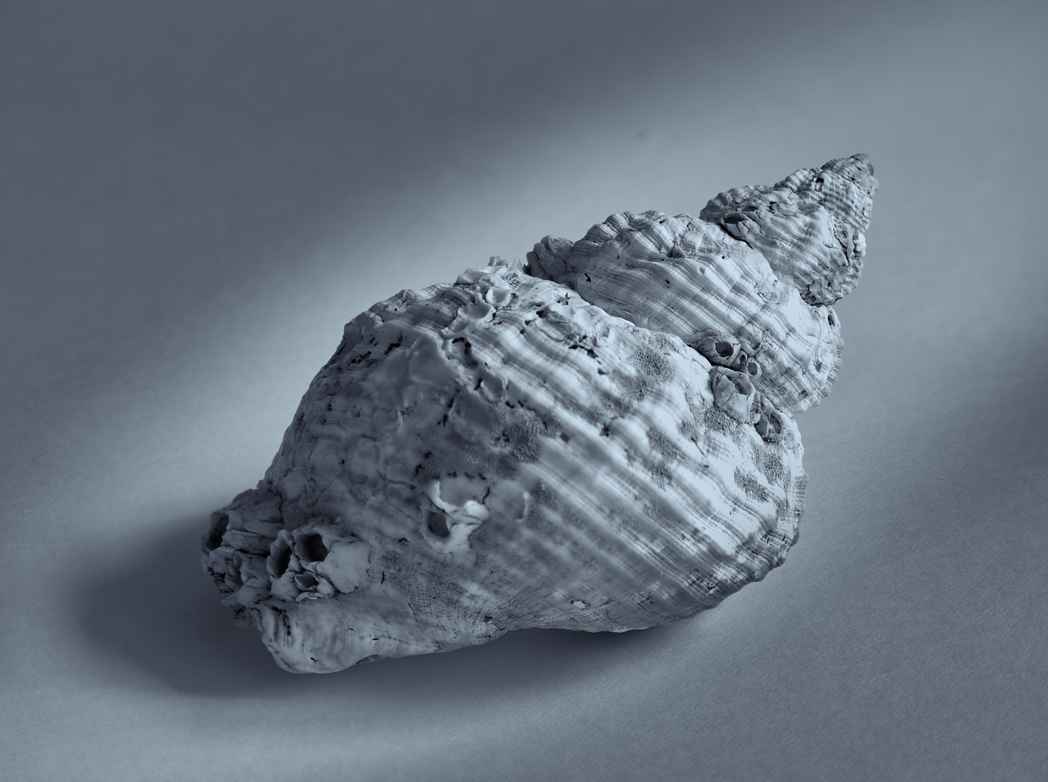
Processed with Helicon Focus

Slide 40
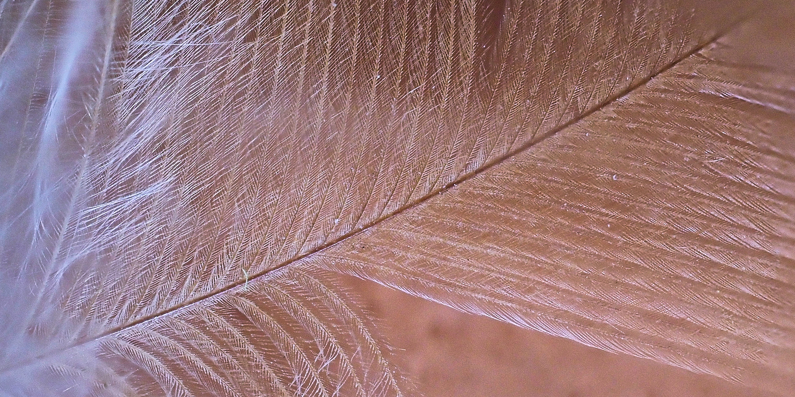

Slide 41
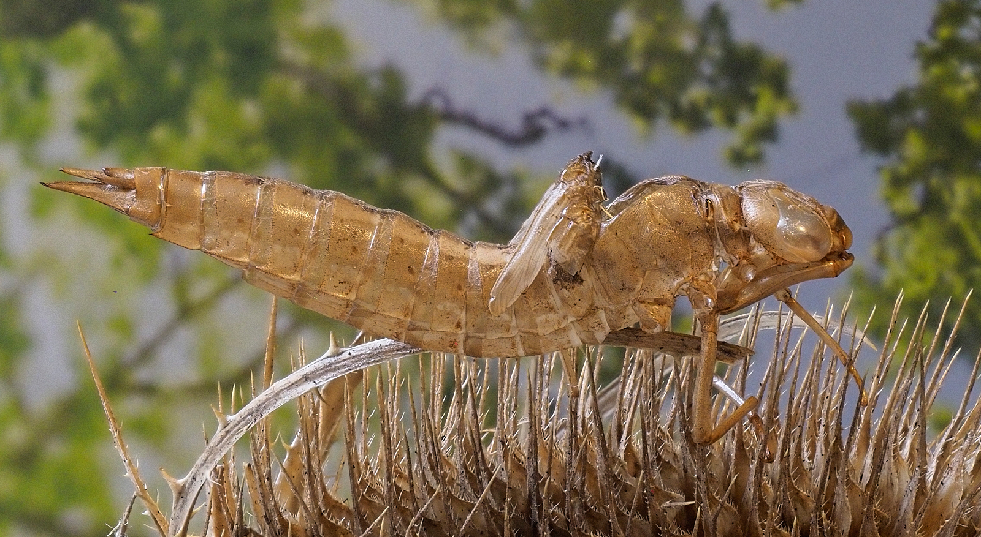

Slide 42
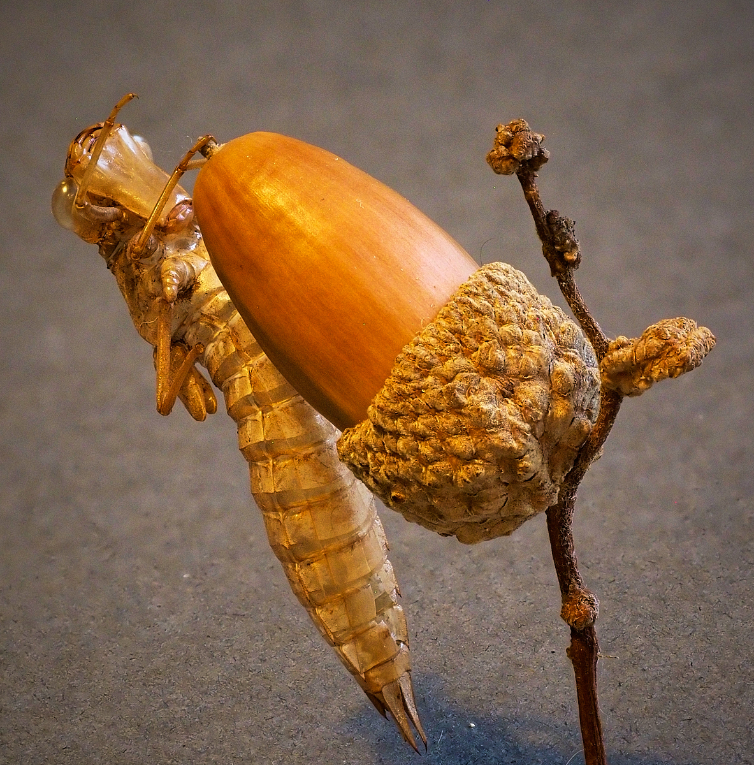
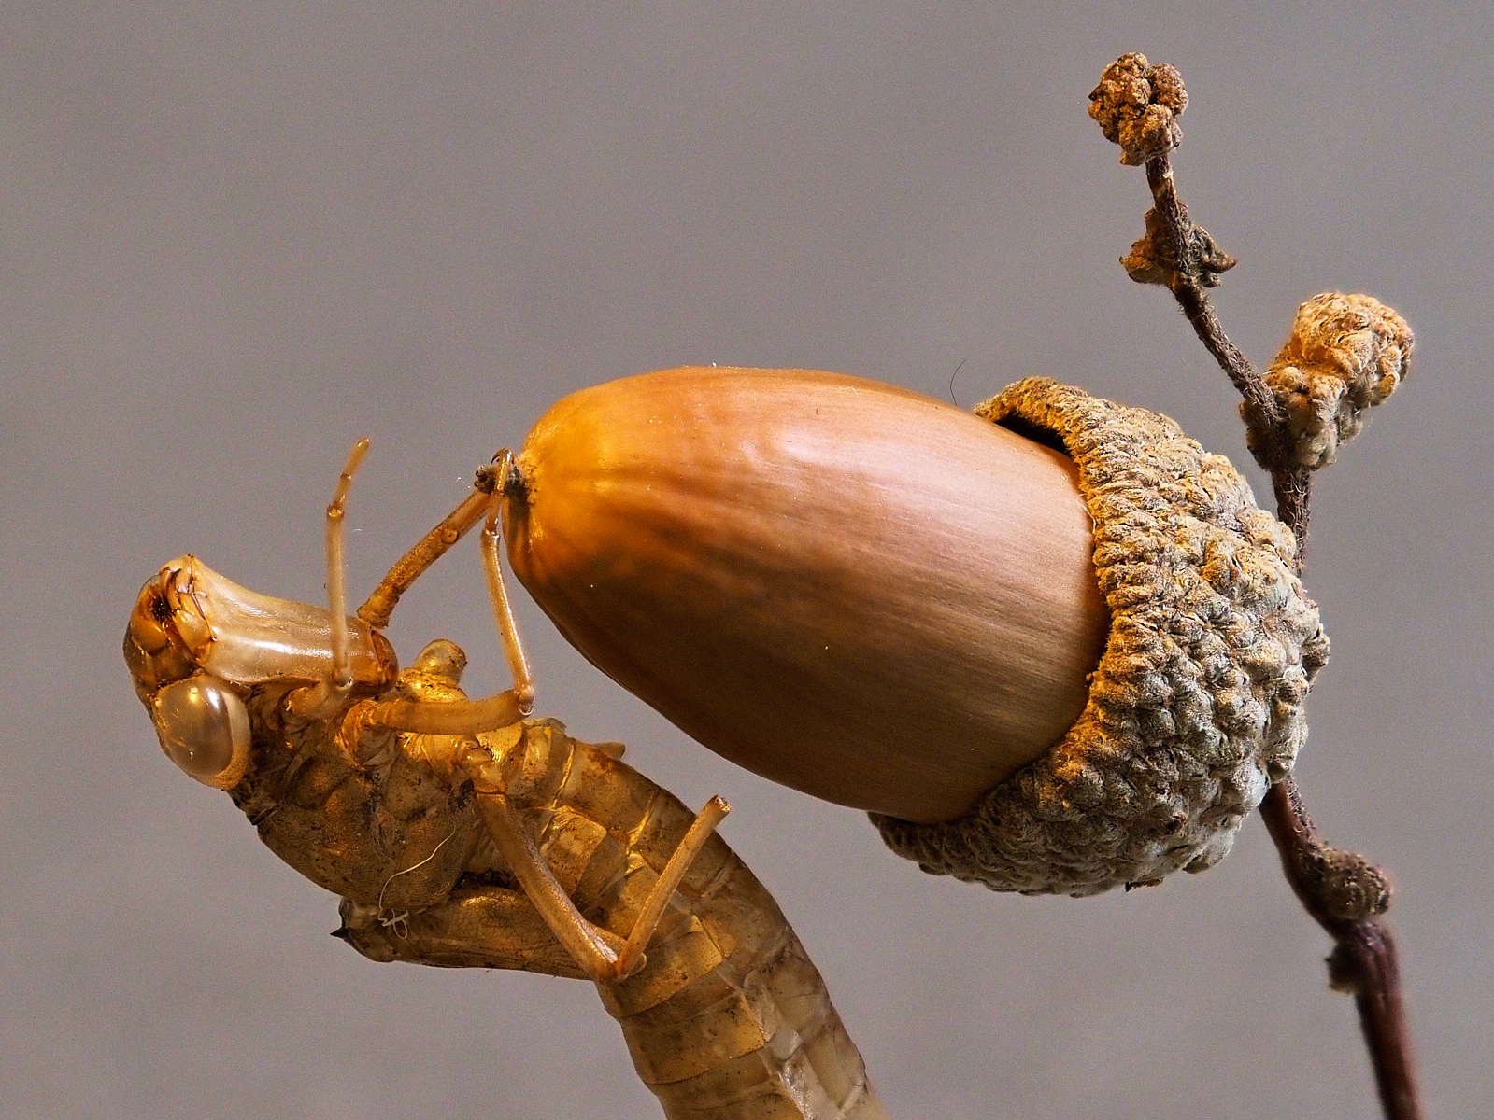

Slide 43
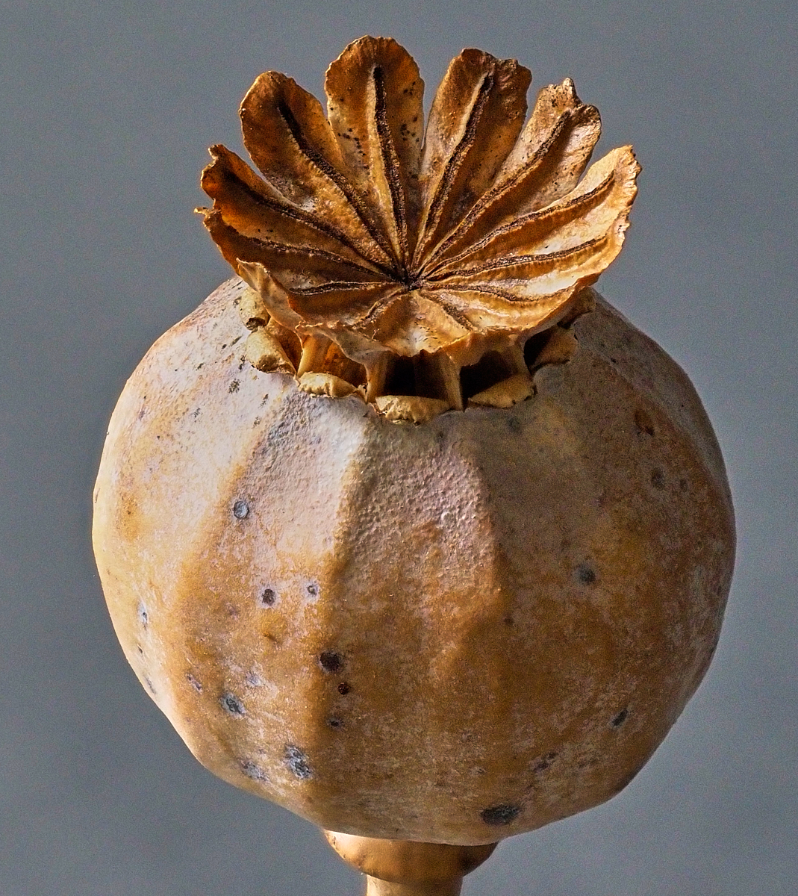
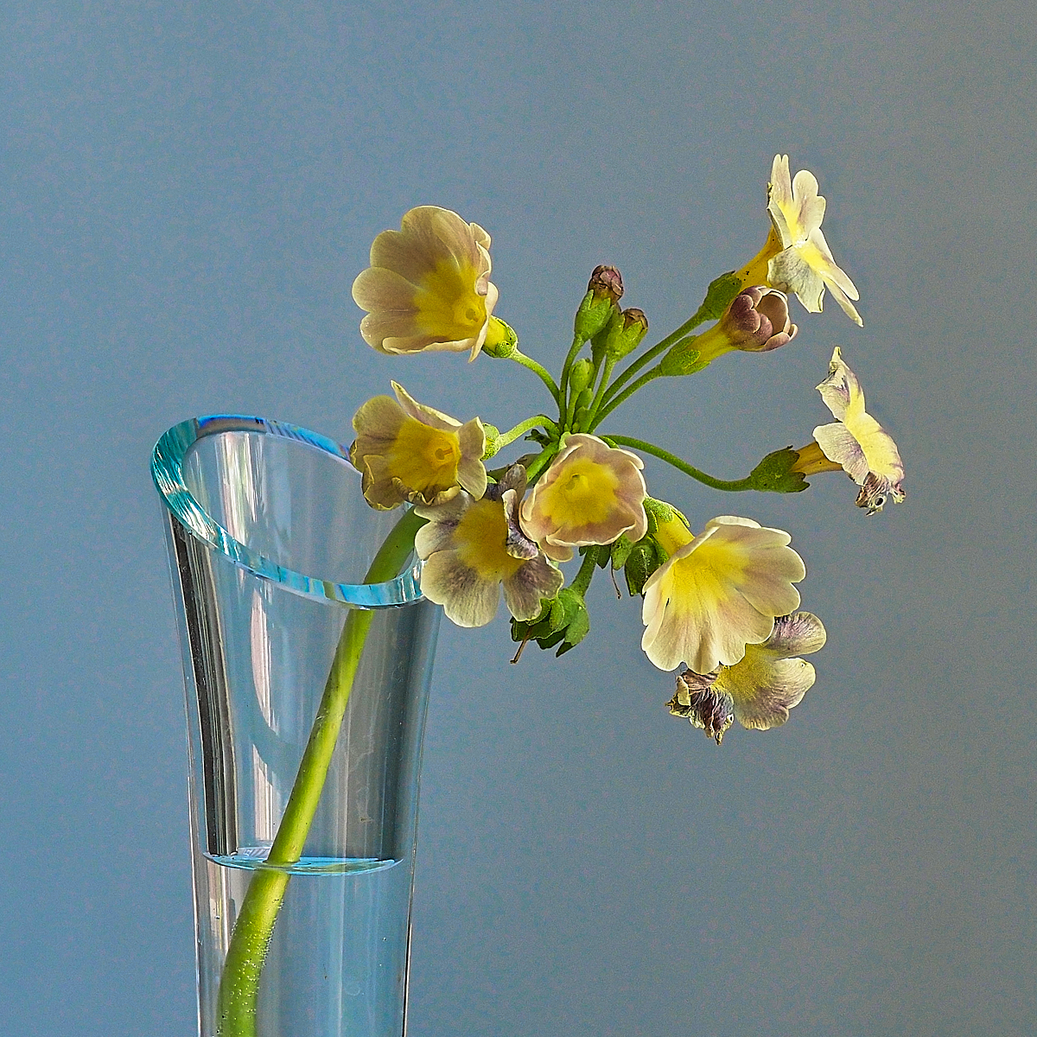

Slide 44
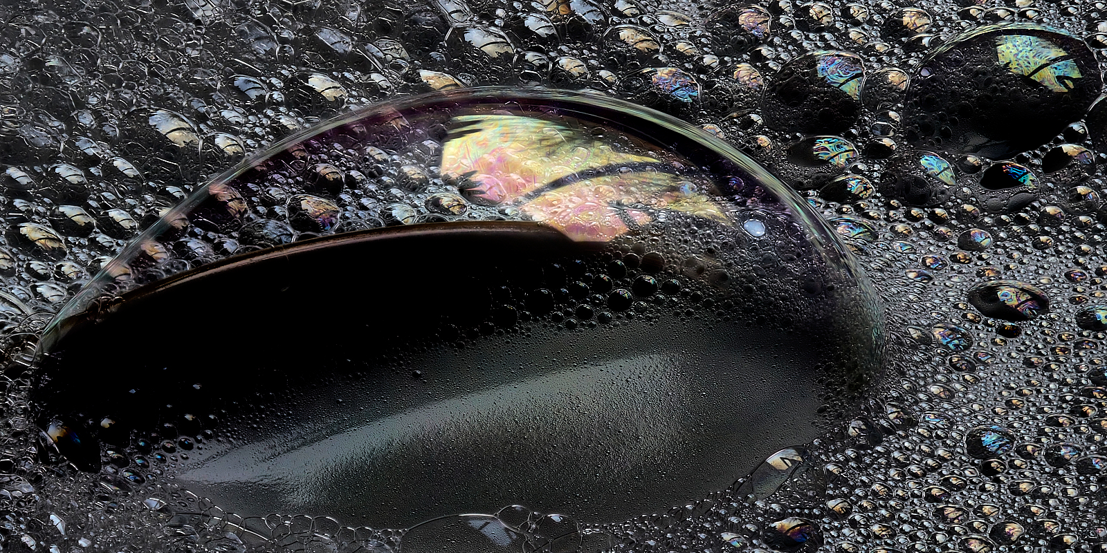

Slide 45
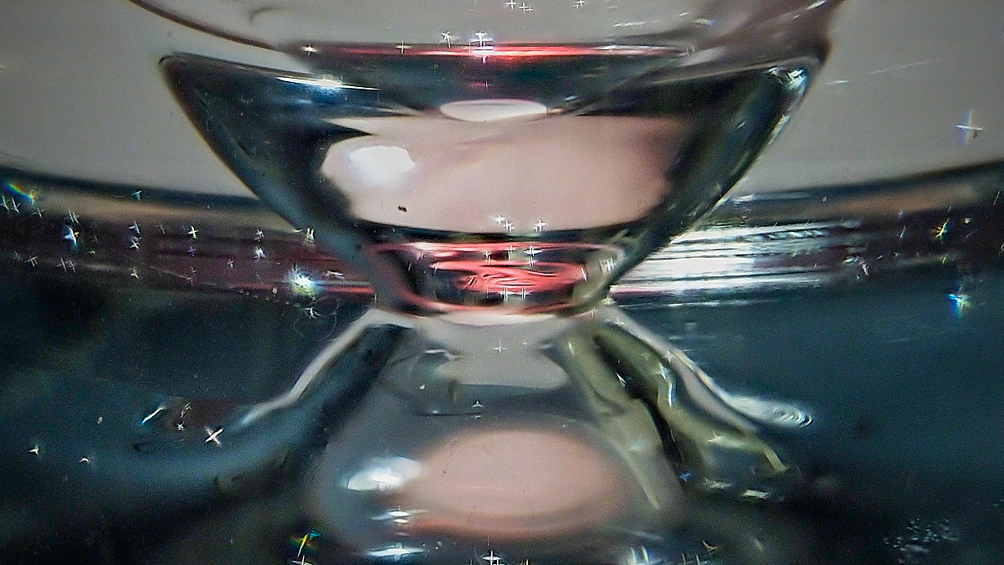

Slide 46
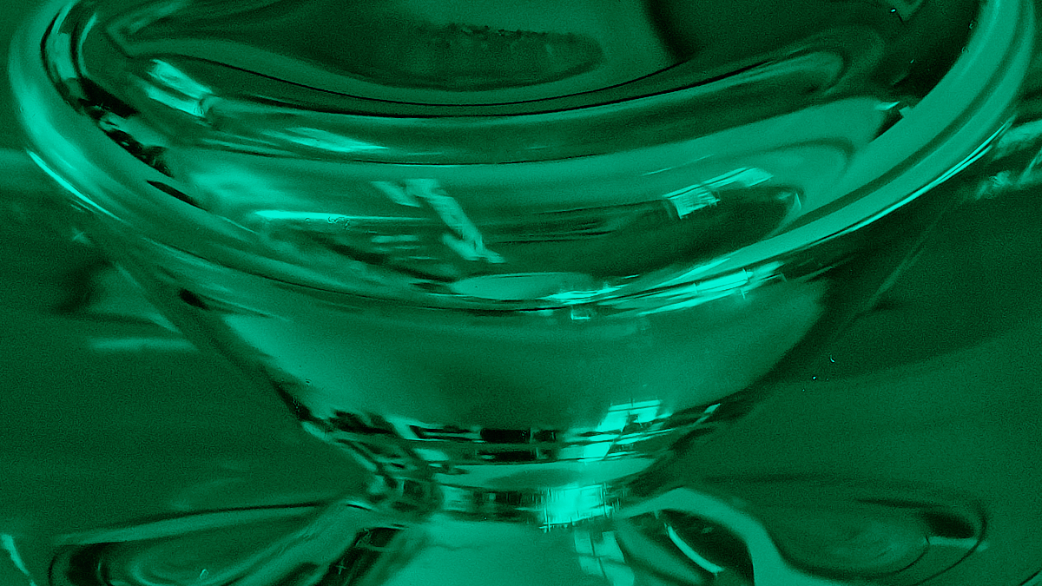

Slide 47
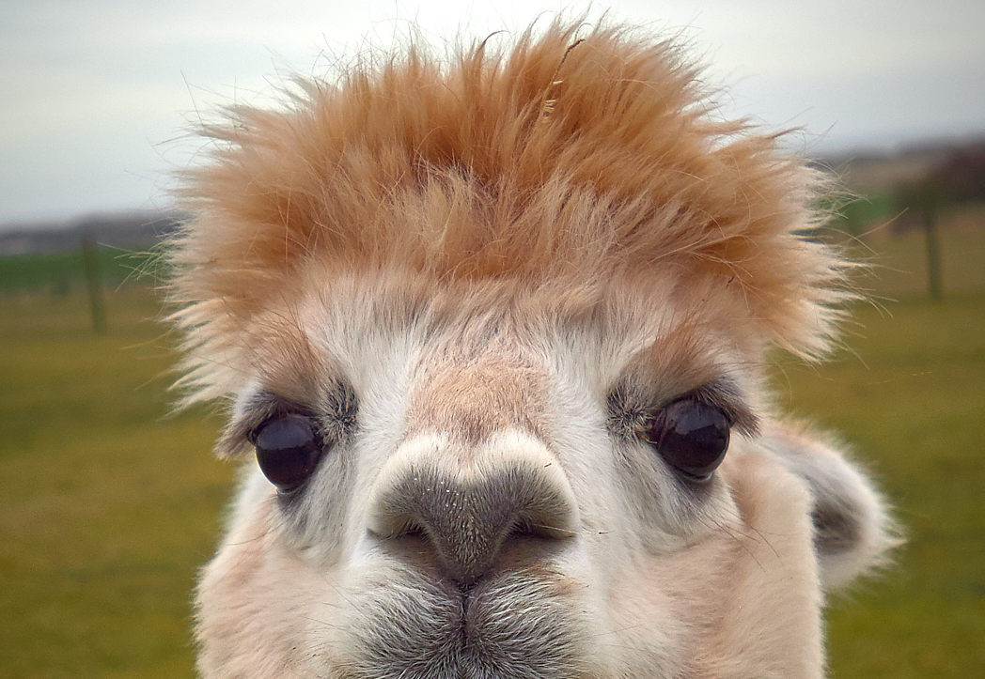

Slide 48
For Further Information
See website of Dr Robert Thompson FRPS FIPF
www.robertthompsonphotography.com
Book by the same author: Close up and Macro Photography-Its Art and Fieldcraft Techniques Published by Focal Press ~£36 expensive but worth it

